Slide 1
Metallic Wall Climbing Robot
B21120 ROHIT YADAV
B21133 SHREYA GARG
B21035 AMAN ALI KHAN
B21152 DEEPAK KUMAR
B21176 ADARSH SANTORIA
B21002 ACHINT DHAMA
Mentors:
Dr. Amit Shukla
Dr. Jagadeesh Kadiyam
TA:
Ayush Gupta
Group-11

Slide 2
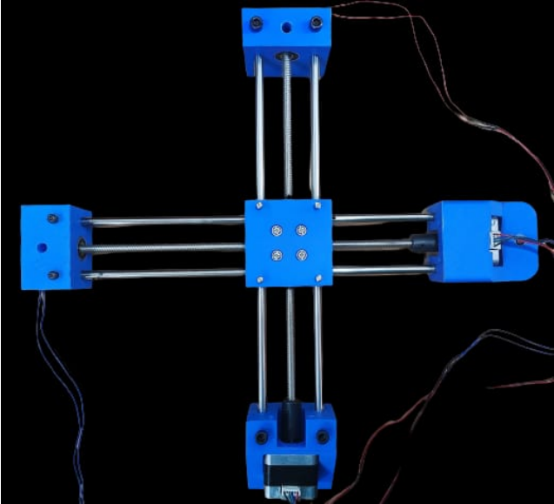
The Problem Statement
We are surrounded with many metallic vertical surfaces, tanks and pipes to name a few.
These structures require inspection, maintenance and cleaning which are complex and dangerous tasks if done manually.
To ease these processes, we are attempting to create a Wall Climbing Robot for metallic surfaces.

Slide 3
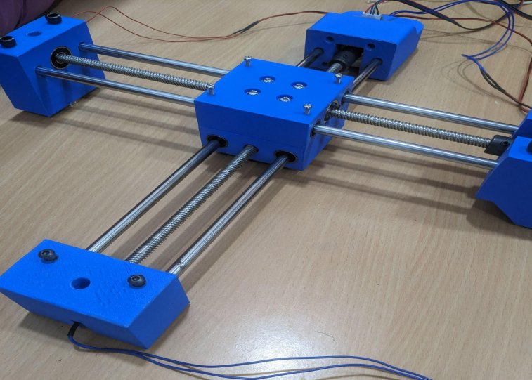
Scientific Principles of the Robot
Magnetic Adhesion Method
It is based on the principle of adhering of ferromagnetic materials to the magnets.
As the surface on which the robot will move will be made up of ferromagnetic materials, we have decided to use magnetism for movement.
Electromagnets should provide enough adsorption force to ensure the adaptability on the working surface.
Further implementation include attachment of robotic arm at center chassis for any kind of operation.

Slide 4

Design Configuration and Calculations
Size of Bot = 310 x 290 x 100 mm
Approximate weight of Bot = 3kg,
Approximate weight of robotic arm or other components = 3.5 kg,
Required opposing force = 65N
Load carried by each electromagnet = 8kg
Torque required for the motion = 4 kg.cm
Torque provided by the motors used = 4.3 kg.cm

Slide 5
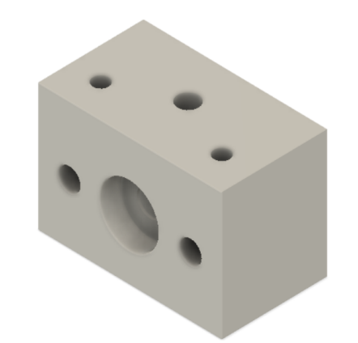
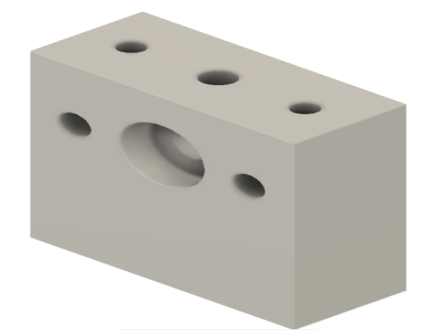
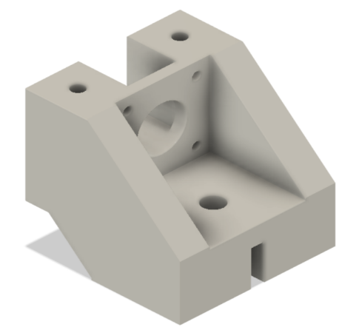
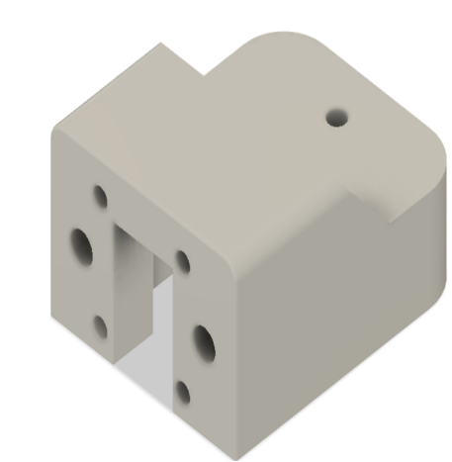
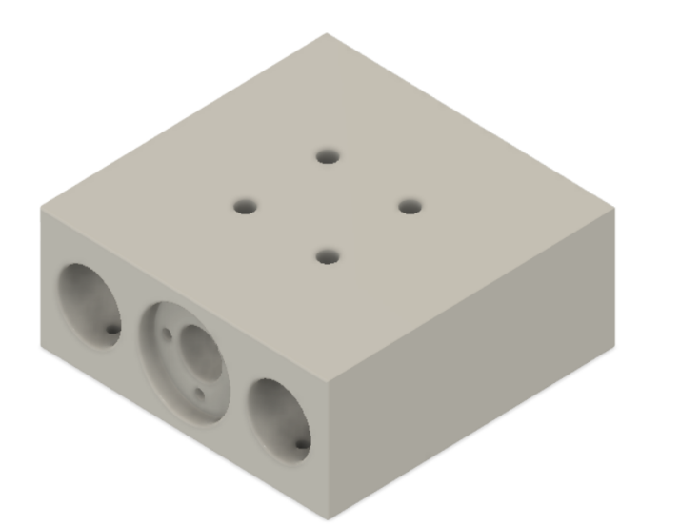
Design
1)
CAD Models of the Prototype
Bearing Mounts
Motor Mounts
Center Chassis
2)
3)

Slide 6
Components Required
Component Name | Quantity | Use
Electromagnets (12V, 8kg, 25mm Dia) | 4 | To provide and adjust magnetism
Stepper Motor (NEMA17) | 2 | For the motion of the bot
Smooth Rod (30 cm) | 4 | For smooth and stable motion of the bot
Lead Screw (2mm Pitch) | 2 | Moving the bot forward and backwards
PLA Filament | 1kg | For 3D Printing of 5 blocks

Slide 7
Components Required
Component Name | Quantity | Use
Arduino UNO | 1 | Used as a microcontroller
Arduino CNC Shield | 1 | For connecting the Motor Drivers to the Arduino
Motor Driver Board | 2 | Helps to control the stepper motor from microcontroller
AC Adapter | 1 | Converts AC to DC (12V, 5A)
Camera | 1 | To capture the live video feed

Slide 8
Components Required
Component Name | Quantity | Use
Bluetooth Module | 1 | Helps in controlling the bot through Bluetooth
Linear Bearings | 8 | Used to impart linear motion
Bearings | 2 | Used for transmission of motion
Coupler (5mm) | 2 | To join motor with Lead Screw rod for motion of Lead Screw
2 Channel Relay | 1 | To switch between electromagnets

Slide 9
Thank You

